Slide 1
Operator Training ReAccelerator Controls (Part 2 of 2)
Tasha Summers Accelerator Controls Physicist III

Slide 2
Outline
Topics for Today
ReAccelerator Launch and Status pages
Device controls: Magnets, RF, diagnostics
Performing an energy change
Monitoring and troubleshooting during an experiment

Slide 3
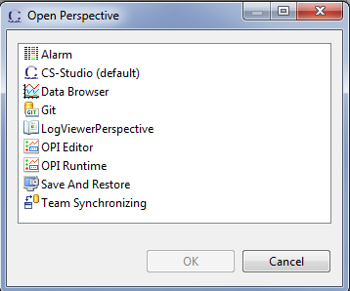
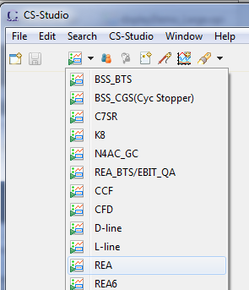
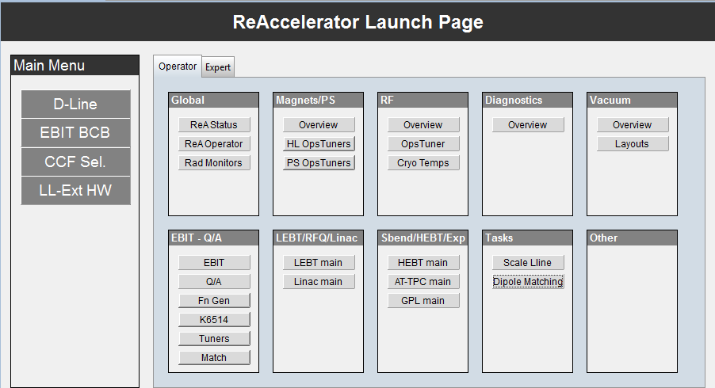
ReA Interfaces: Launch Screen
Getting to the ReA Launch page:
Best to work in OPI Runtime
Perspective
Select REA
from top-level
menu
Organized by
system (top)
area (bottom)
expert (2nd tab)
All buttons here open
other pages

Slide 4
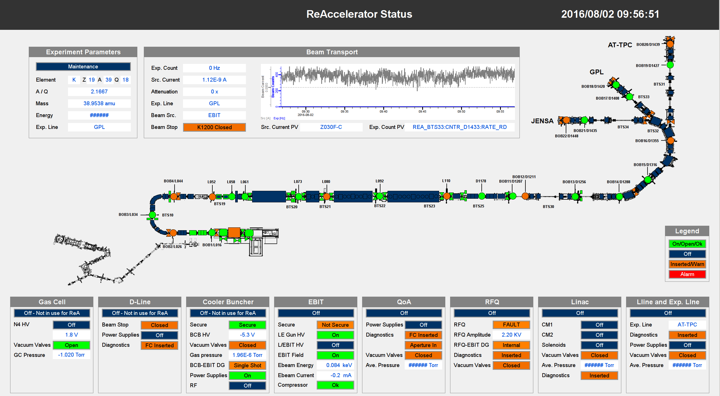
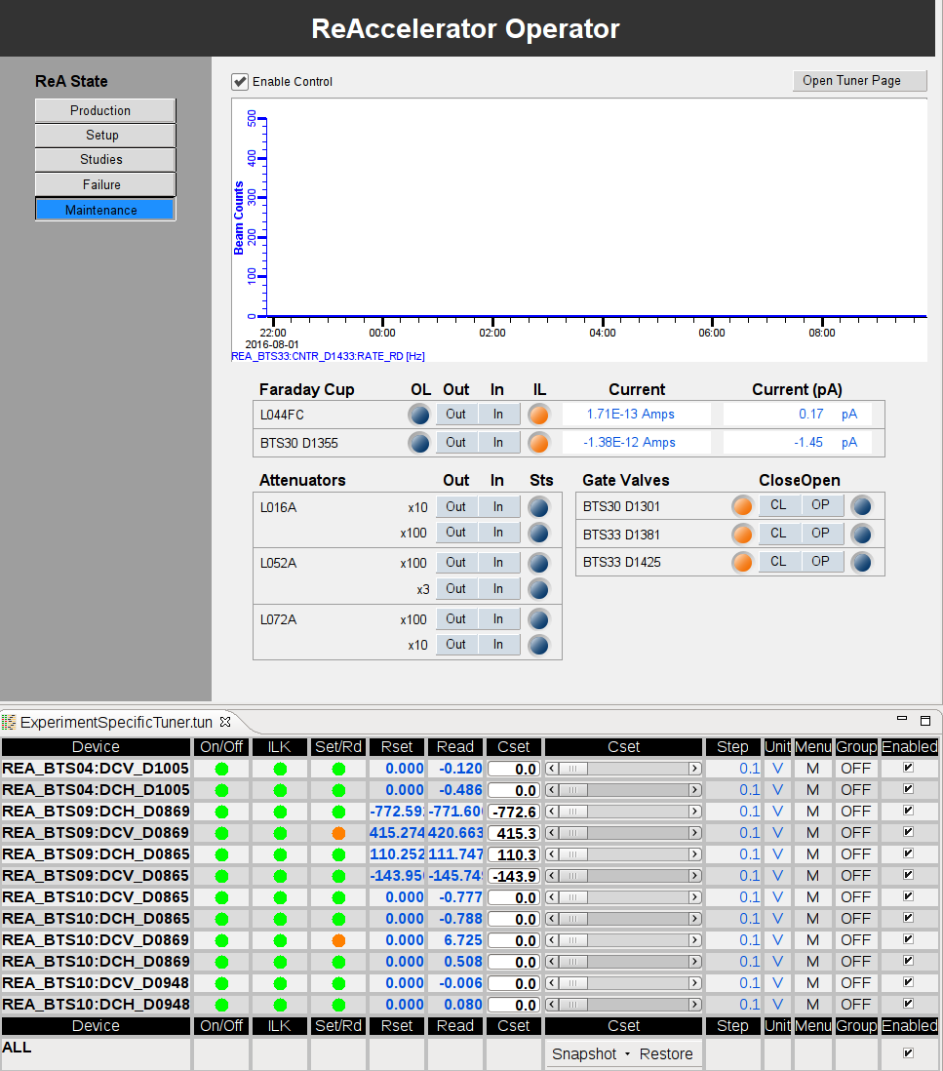
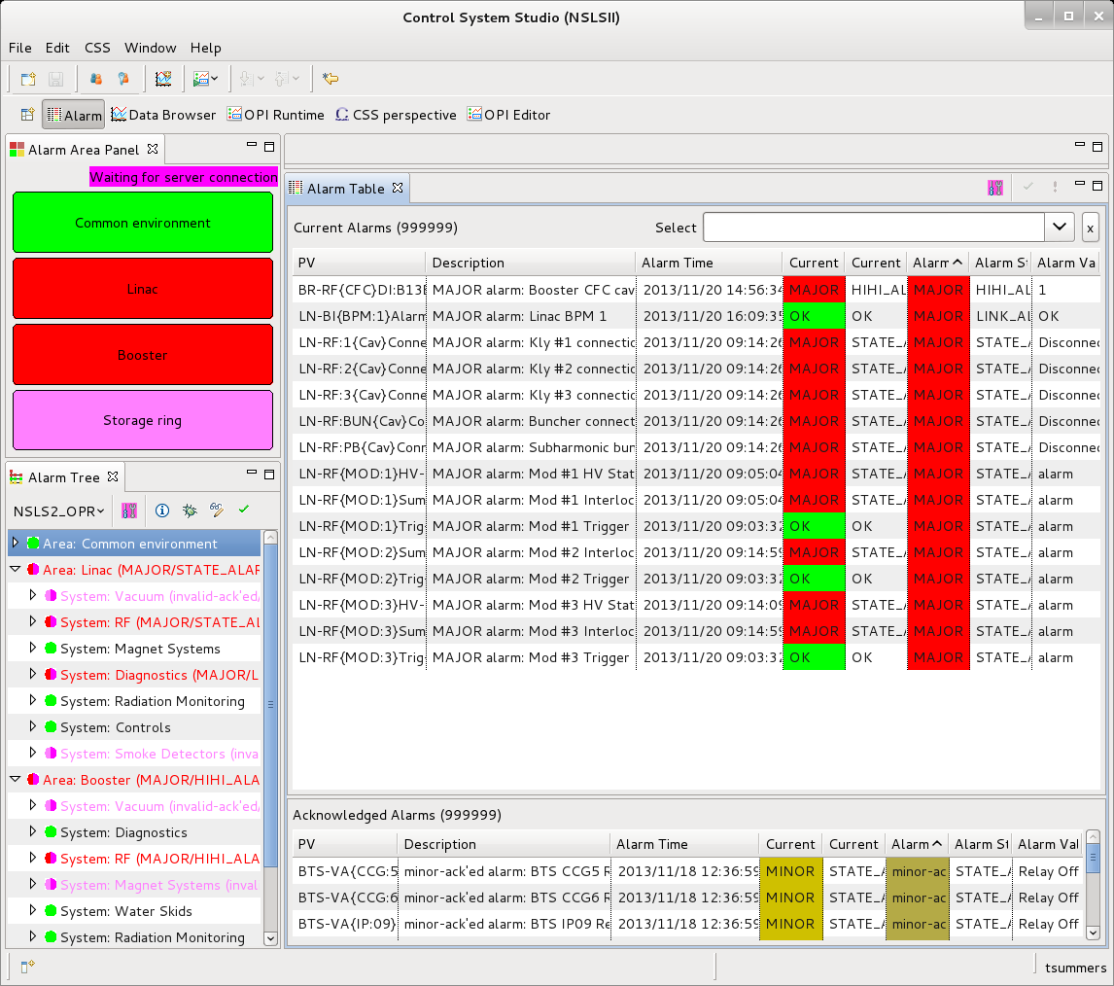
ReA Interfaces: Expected Use
For monitoring always have open:
Status Page
Beast
For tuning
Operator page updated for specific experiment
Top-level area overviews

Slide 5

ReAccelerator Status
Expect Status page to be updated frequently for next couple months.
Some colors will be adjusted to make problems more obvious.
Summary sections at bottom will be expanded/rearranged.
Top section – beam and experiment information and history
Middle section – equipment status with focus on on/off, in/out
need to add D-Line
areas not in use changed to grey
switch to official device shapes
Middle section – equipment summaries, important values

Slide 6
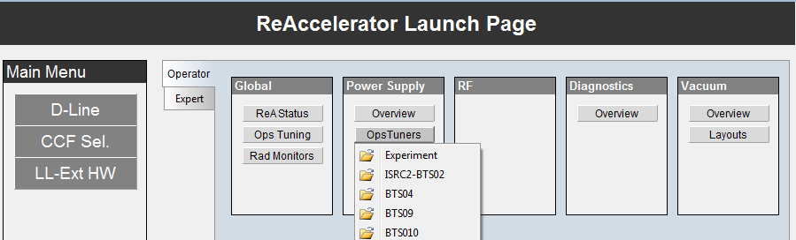
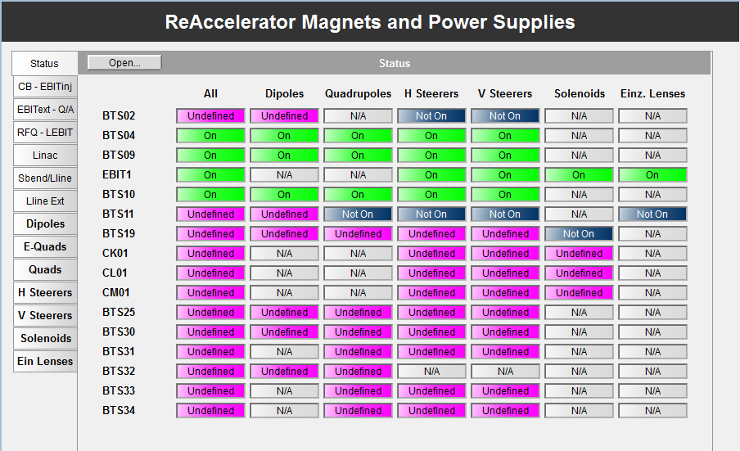
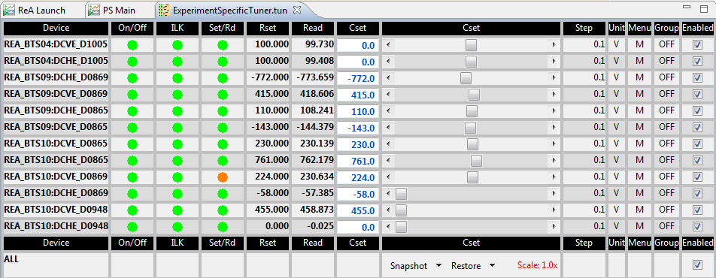
Device Controls: Magnets
2 main ways of accessing magnet/power supply controls
Overview/ and OpsTuners (High-level and power supply)
Use high-level pages – provide ‘tuning’ alarms and physics info
also combine multiple power supplies for electrostats

Slide 7
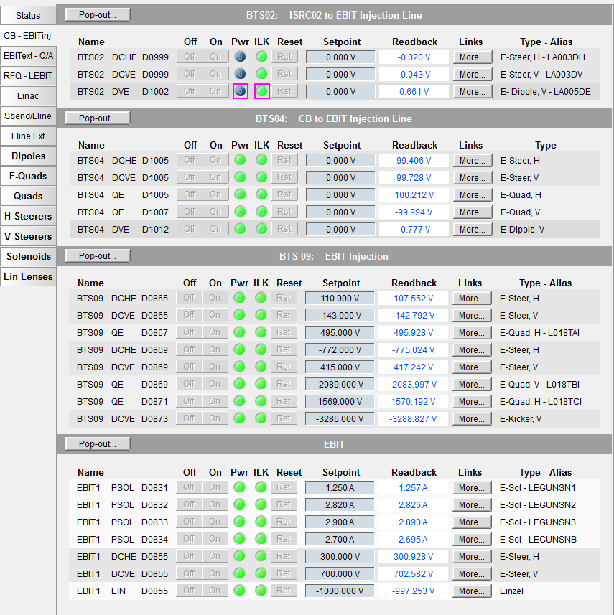
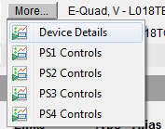
Control Pages: Magnets
Pop-out the section into another tab or window
‘More…’ button has links to Device (magnet/electrostat) details and to power supply details
Readback column will have alarm-sensitive border for set/read mismatch

Slide 8
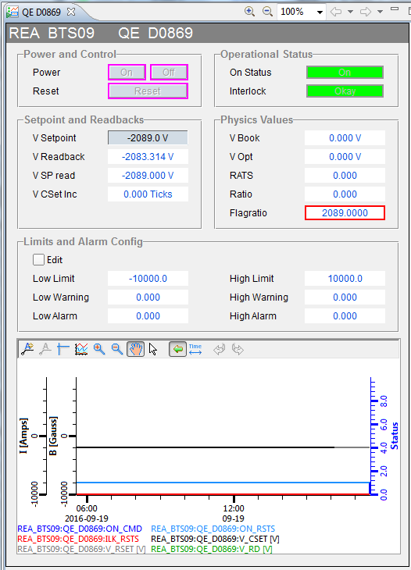
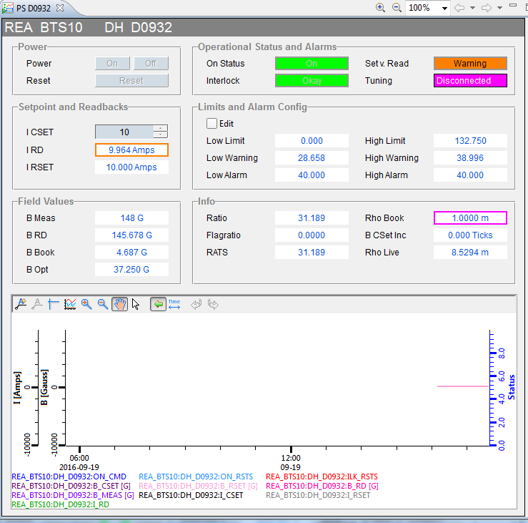
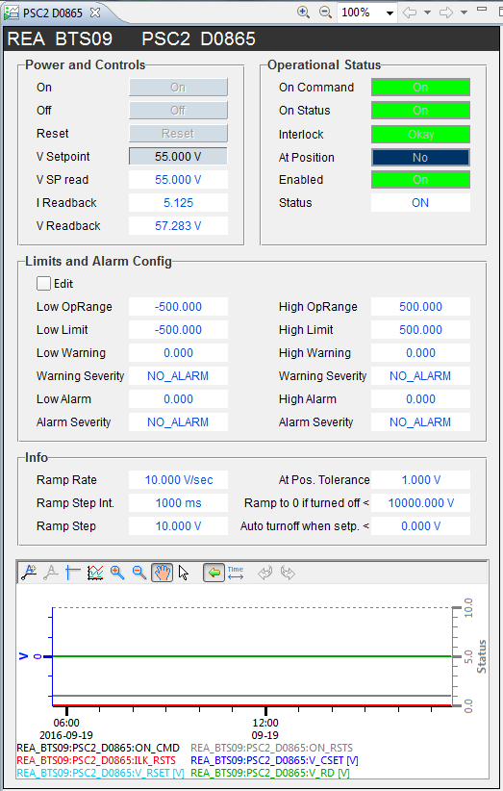
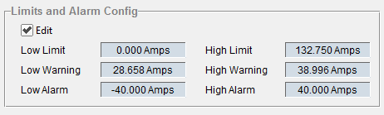
Control Pages: Magnet Details
Electrostat details
Magnet details
Power Supply details
Access operator and alarm limits

Slide 9
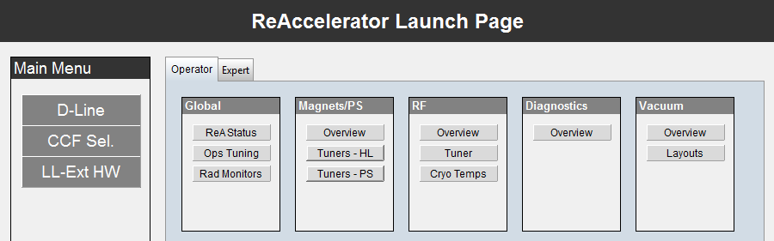
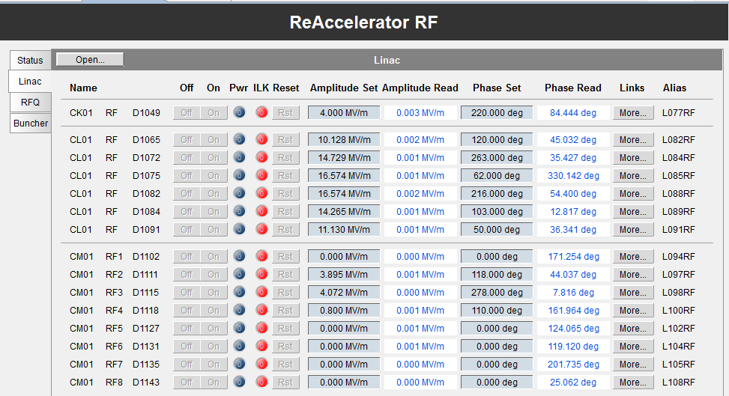
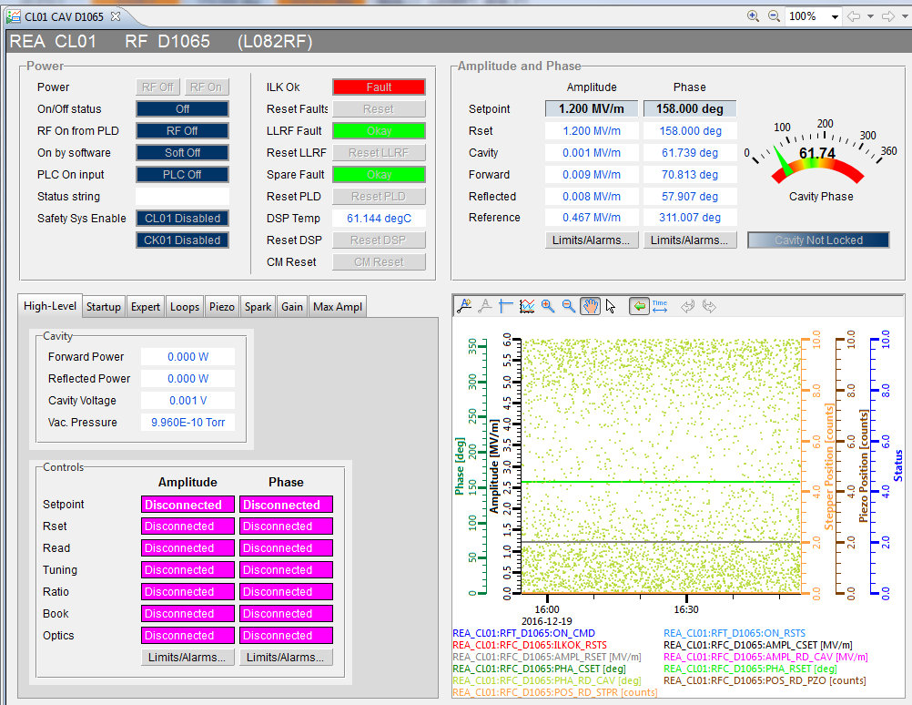
Control Pages: RF and Details
Currently 2 main ways of accessing RF status and controls
Overview and OpsTuners

Slide 10
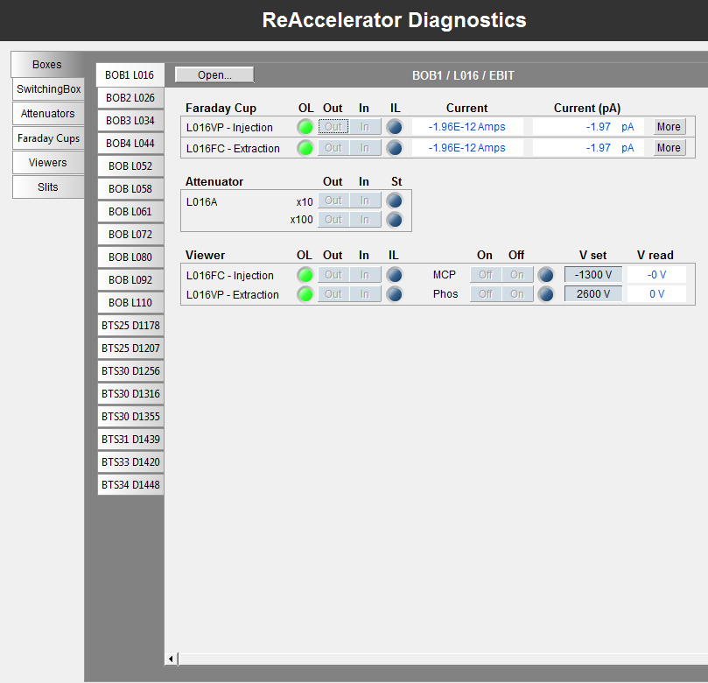
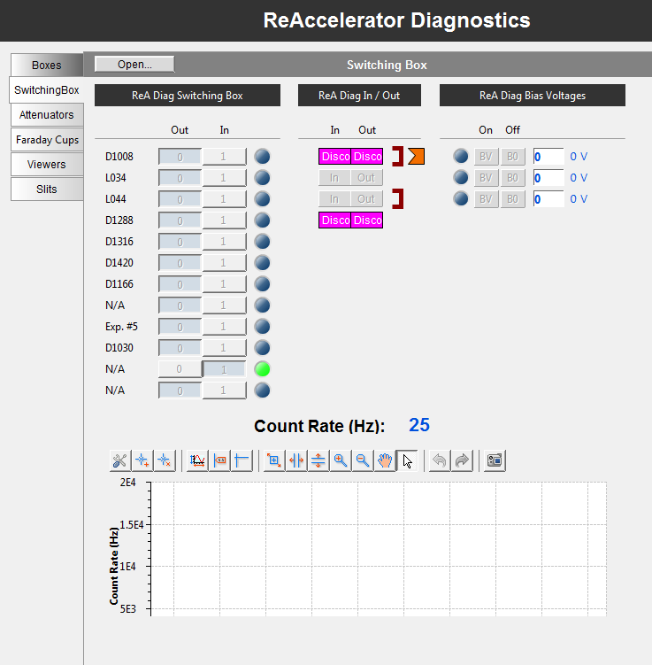
Control Pages: Diagnostics
Available on Area Overview pages or Diagnostics Overview

Slide 11
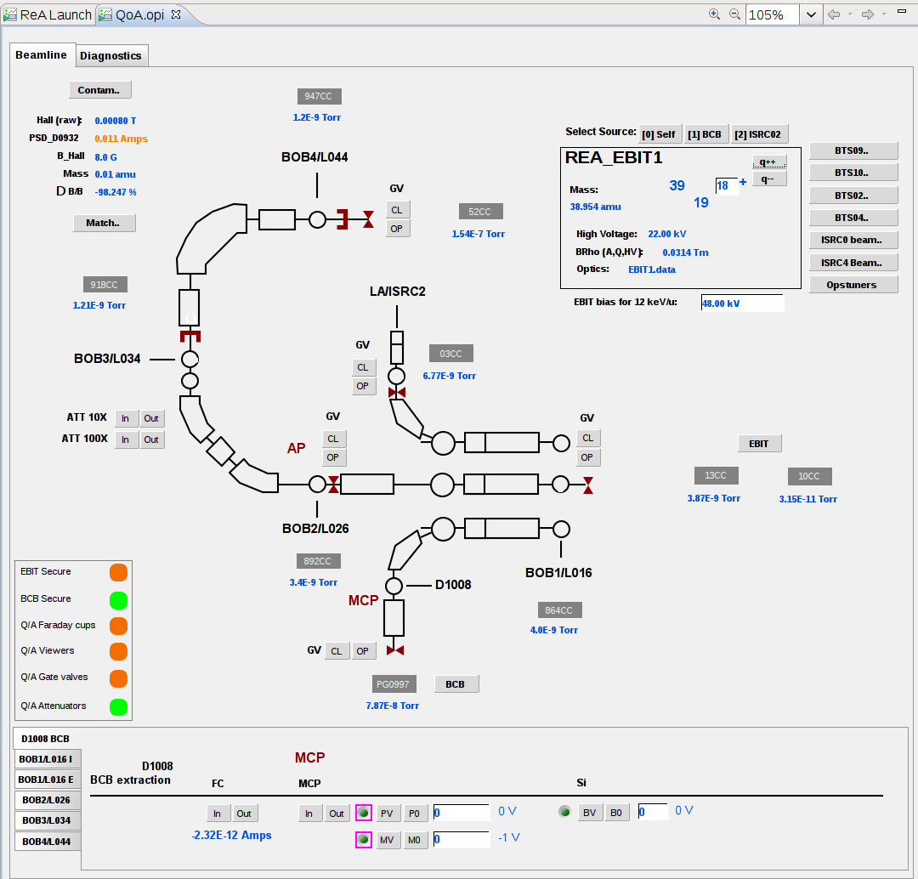
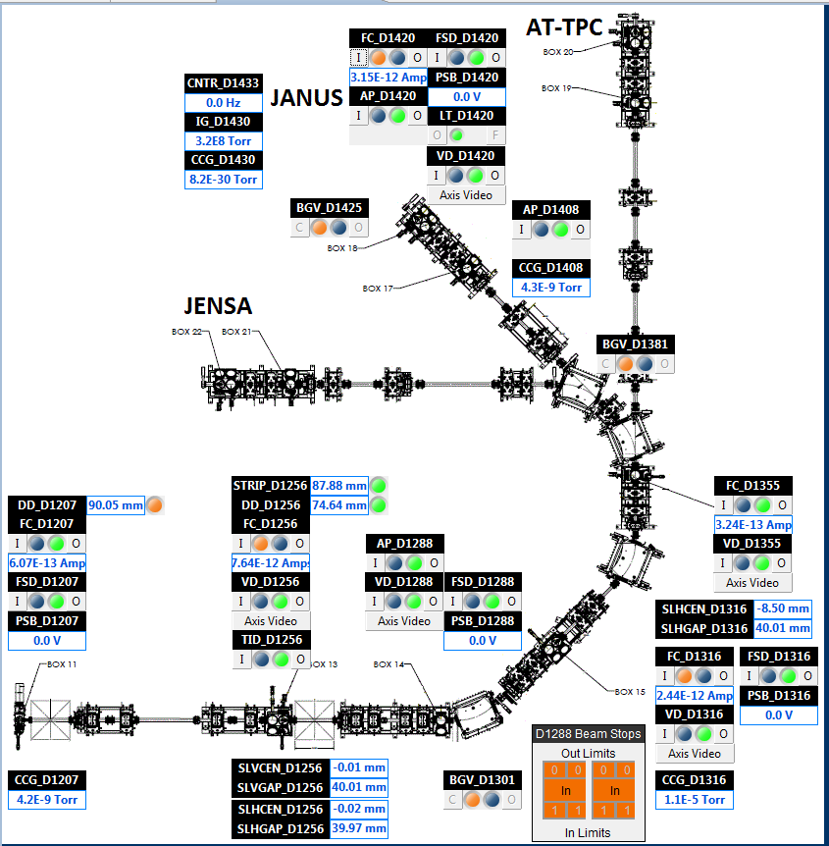
Operator Overview Pages
Status and common controls for a section of the accelerator
These are next on the list of pages to update so they may change significantly in the next few months.

Slide 12
Energy Change: at a glance
Establish State
Scale L-Line
Change Energy & Verify Matching
Re-establish State & Record Process

Slide 13
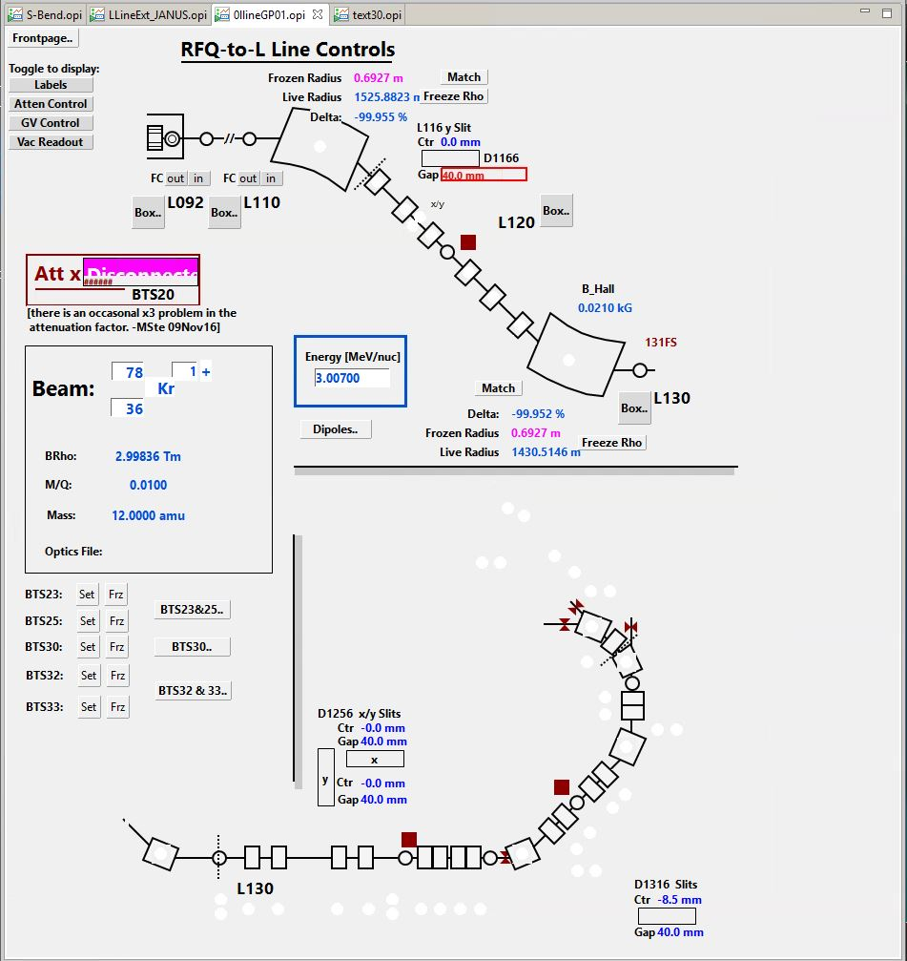
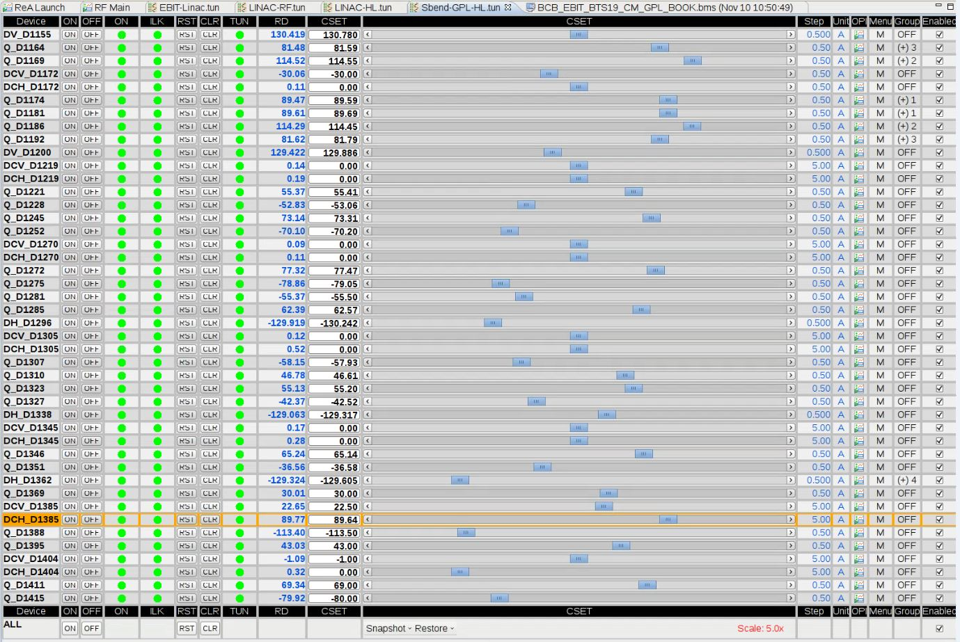
Energy Change: Establish State
Establish State
Check and clear alarms
Verify that beam scaling channels are where they should be

Slide 14
Energy Change: Establish state cont.
Checking notable information
Status Page
Beast
Operator Page
Experiment count rate..
Slit gaps, position..
RF stability…
Dipole Drift…
Non-tuning alarms…

Slide 15
Energy Change: Establish state cont.
Establish State
Check and clear alarms
Verify that beam scaling channels are where they should be
Check notable information
Make a Saveset
Make sure devices that are OFF have setting of zero
Scroll through the saveset, make sure no errors pop out at you
Make sure to refresh, and that you can find the save after having done so
Change hourlog state to PDT once you have the beam
Saveset picture

Slide 16
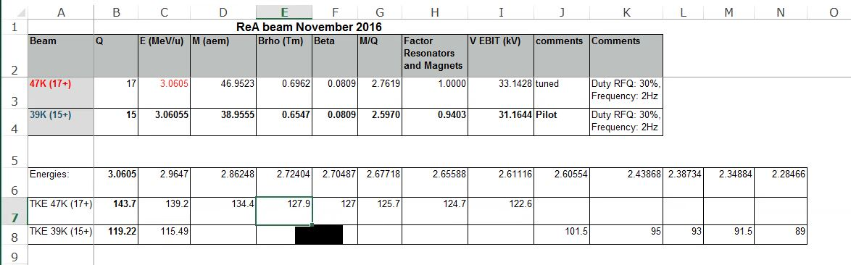
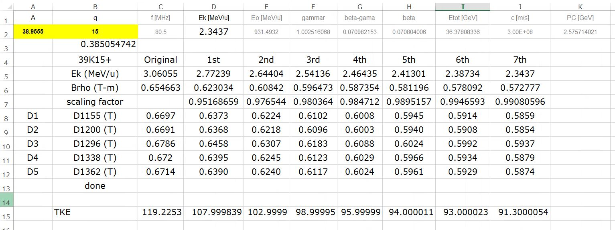
Energy Change: Scaling
Scale L-Line
Reference provided charts
Verify target parameters are correct with experimenters, logbook, or special instructions
‘projects/rea3/rea3-experiments/<exp# PI>’
Should have beam parameters, mass, charge, brho, energy steps, extra comments
Secondary sheets may have tabled, pre-calculated, dipole field values with reference to intended energy steps

Slide 17
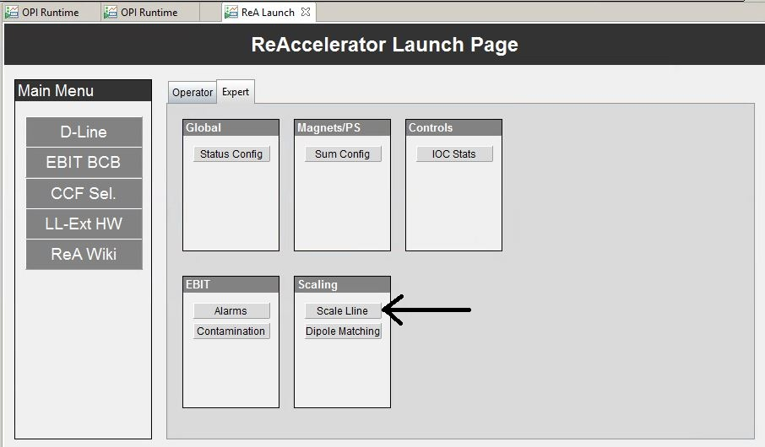
Energy Change: Scaling cont.
Scale L-Line
Verify target parameters are correct with experimenters, logbook, or special instructions
Set target values
Set Scaling channel(s) (Beam Energy)
Tuning alarms should alarm, as are now off from intended values
Set the quads/steerers to their intended values (based on scaling channel values) by hitting ‘set’
tuning alarms should go away once they’ve reach their intended values

Slide 18
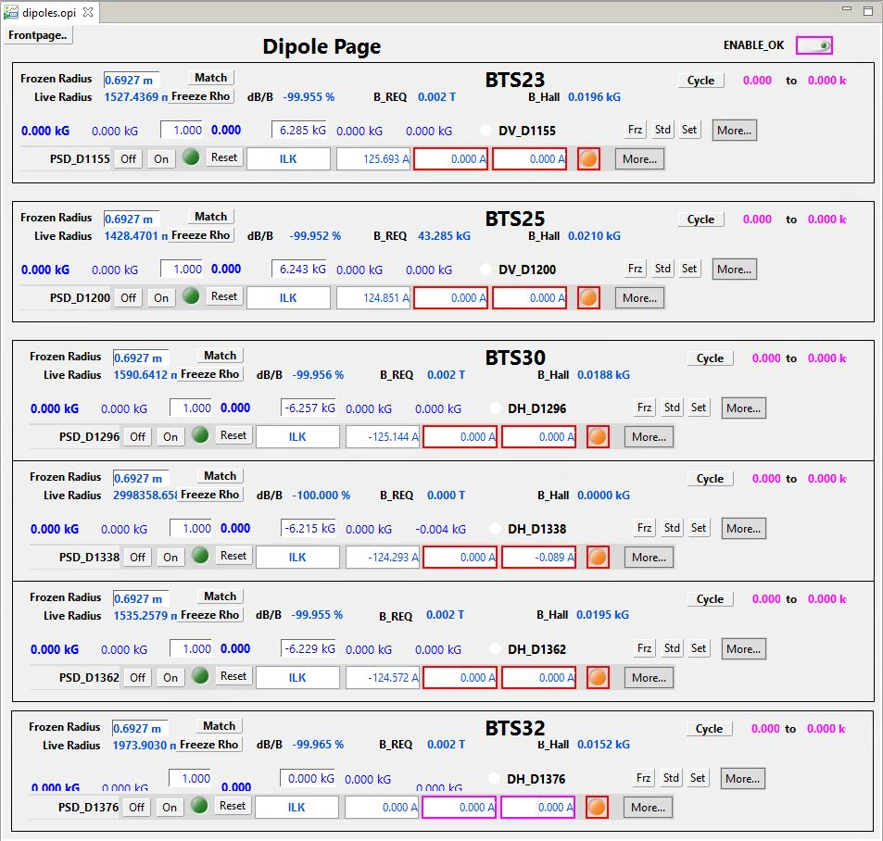
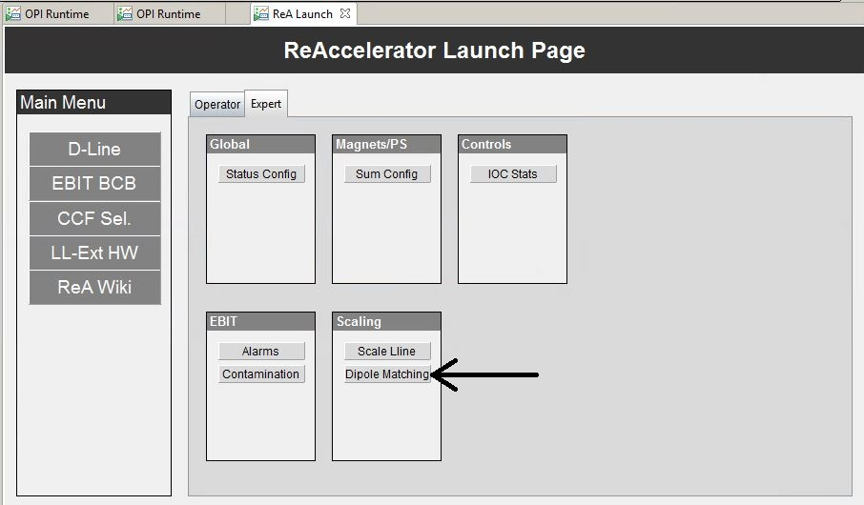
Energy Change: Scaling cont.
Scale L-Line
Verify target parameters are correct with experimenters, logbook, or special instructions
Set target values
Set Scaling channel(s) (Beam Energy)
Tuning alarms should alarm, as are now off from intended values
Set the quads/steerers to their intended values (based on scaling channel values) by hitting ‘set’
tuning alarms should go away once they’ve reach their intended values
Dipole Matching
‘match’ dipoles, make sure that they’re reaching their pre-calculated values
if not, cycle as needed and walk them to correct value
Update hourlog with new beam energy

Slide 19
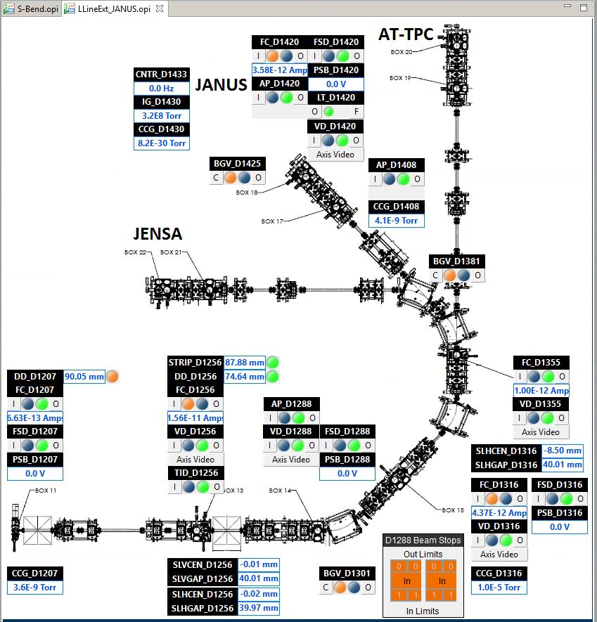
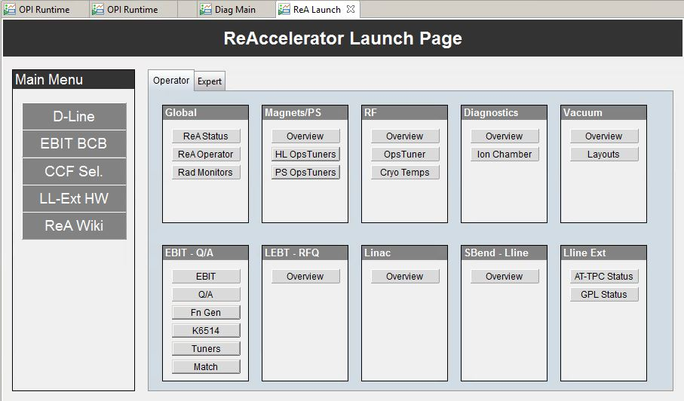
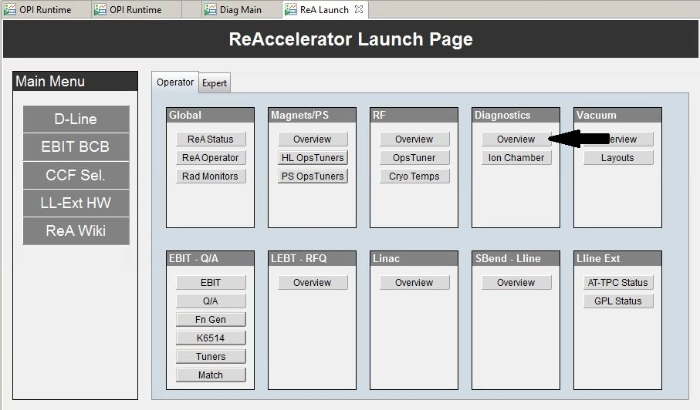
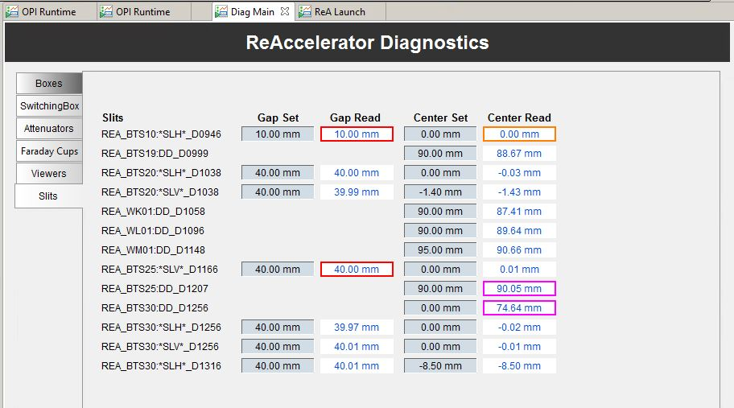
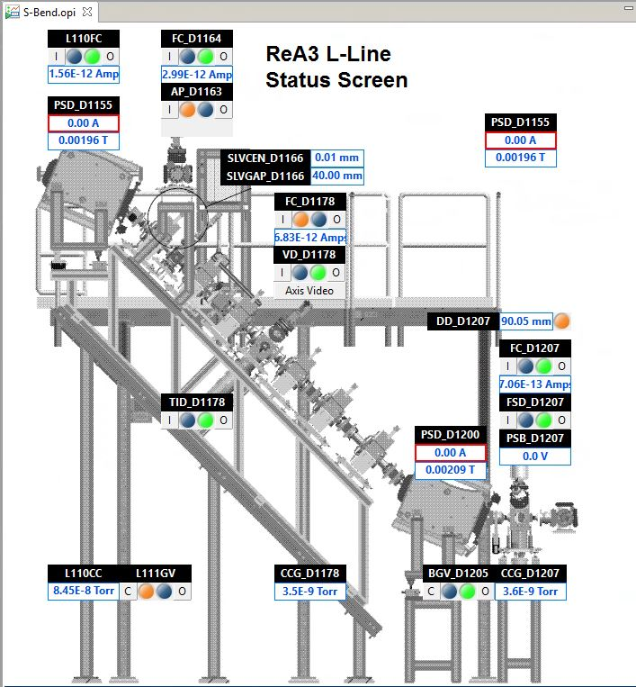
Energy Change: Cavity Amplitude & Matching
Cavity Amplitude & Matching
Decide on verification
S-Bend Slits (D1166), with intermediate quads turned off
D1316 slits, either on transmission or by image
Experimenter’s detector

Slide 20
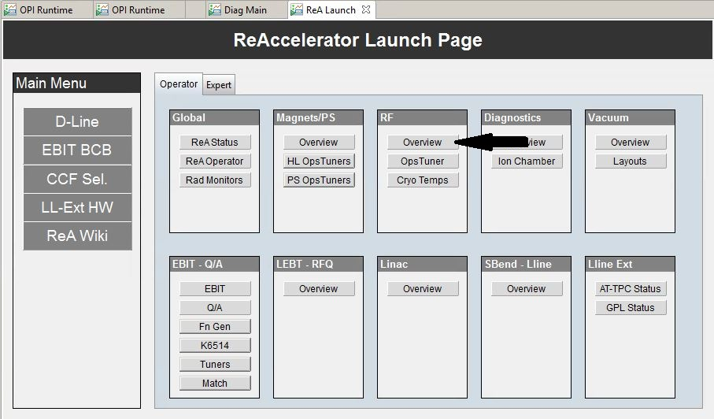
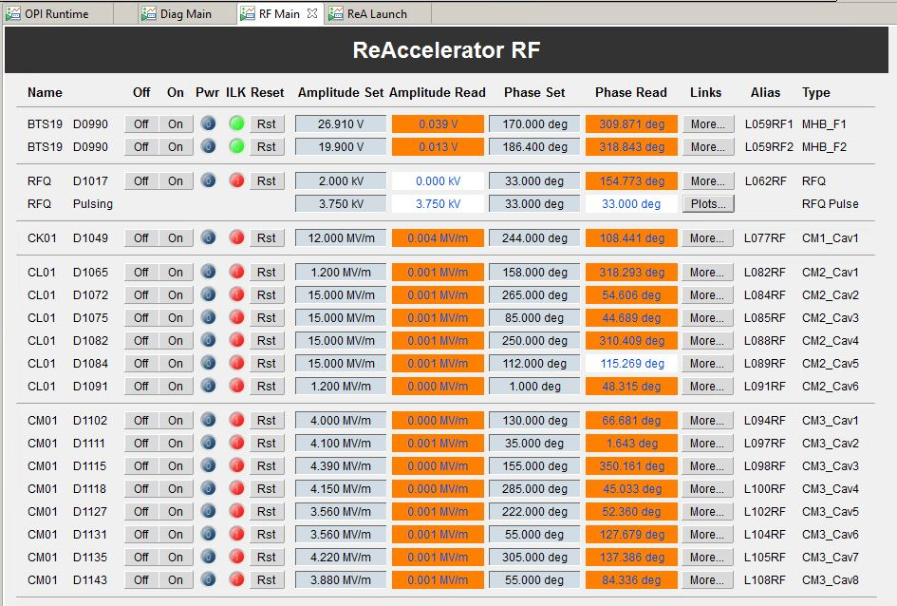
Energy Change: Cavity Amplitude & Matching cont.
Cavity Amplitude & Matching
Decide on verification
Change amplitude of last cavity
optimize using given method of verification

Slide 21
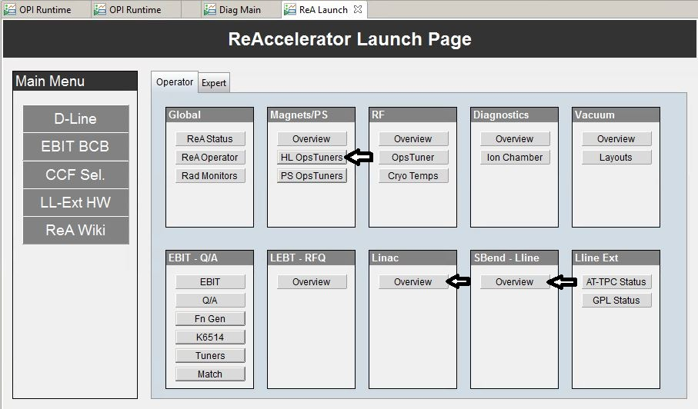
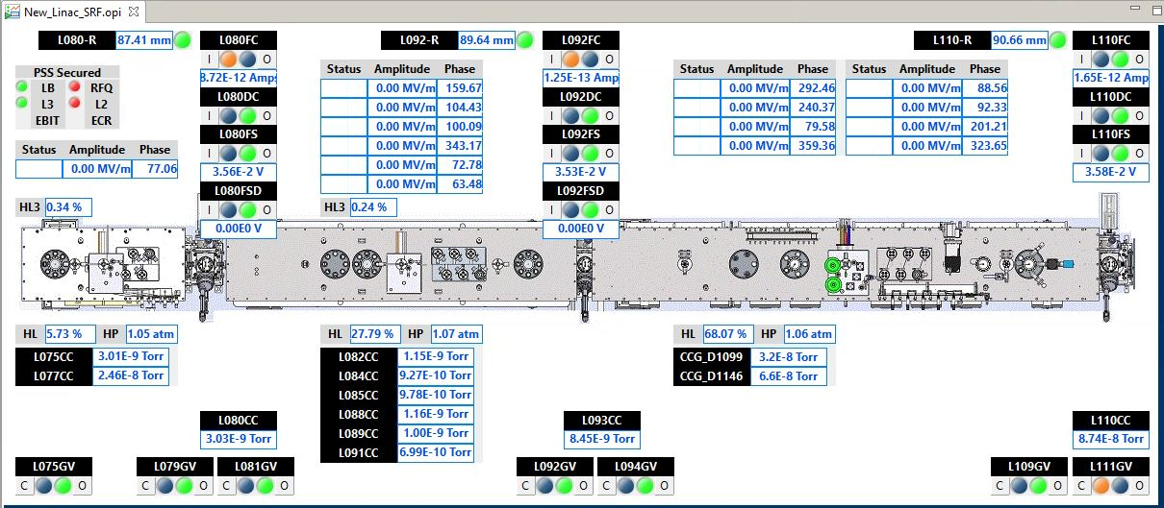
Energy Change: Cavity Amplitude & Matching cont.
Cavity Amplitude & Matching
Change amplitude of last cavity
Make sure your matched from LINAC exit into L-Line
Turn off D1155 dipole
Tune (LINAC solenoids and correctors) to get %50-%70 transmission through L110-R and AP_D1163 5mm apertures and onto FC_D1164 in ‘The Stub’
Turn back on the D1155 dipole, making sure it’s field value returns

Slide 22
Energy Change: Cavity Amplitude & Matching cont.
Cavity Amplitude & Matching
Decide on verification
S-Bend Slits, with intermediate quads turned off
D1316 slits, either on transmission or by image
Experimenter’s detector
Change amplitude of last cavity
optimize using given method of verification
Make sure your matched from LINAC exit into L-Line
Turn off D1155 dipole
Tune (LINAC solenoids and correctors) to get %50-%70 transmission through L110-R and AP_D1163 5mm apertures and onto FC_D1164 in ‘The Stub’
Turn back on the D1155 dipole, making sure it’s field value returns
Double Check the amplitude setting
To make sure it wasn’t the cavities effect on trajectory that is being optimized for transmission, may have to repeat last two steps a few times

Slide 23
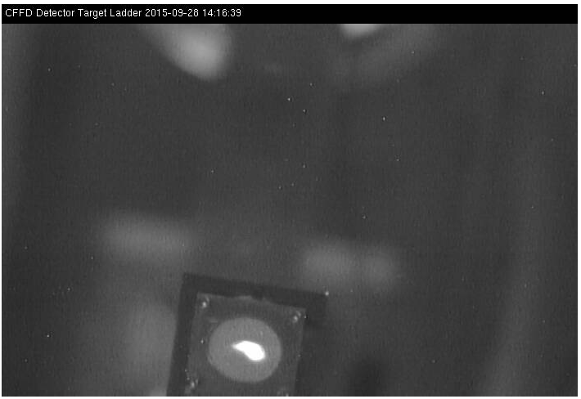
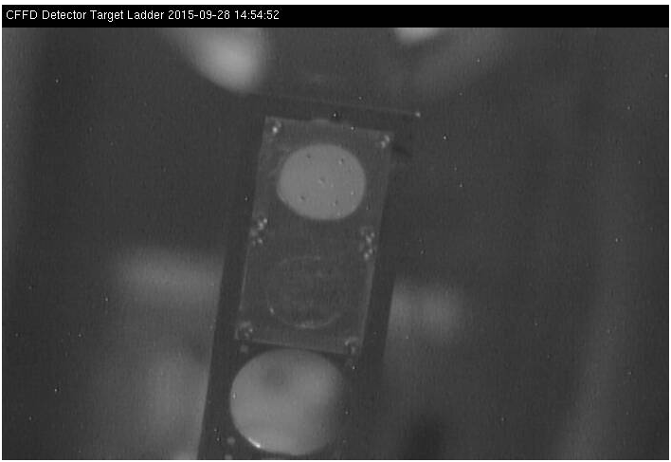
Energy Change: Re-establish, record, & deliver
Re-establish State, Record & Deliver
Does the beam make it through previously set slit positions/gaps
Does beam make it to the end?
What are the count rates of merit, have you restored these rates?
Do you still meet trajectory and position requirements for experiment?
IFF it’s good, make sure any tuning alarms made in this process are cleared (or accepted), that anything turned off is also set to zero, and that a saveset is made.
Speak with experimenters, are they happy with it?
Update Hourlog to EXR when beam is returned to experiment.

Slide 24
ReA Operator Page
Updated for every experiment to provide the most used controls

Slide 25
Troubleshooting – EBIT and Q/A
Look at addition to the obvious:
Status page for obvious: equipment on? valves open?
Use save/restore program to see if something changed
Check Beast for alarms (see alarm guidance if available)
EBIT-specific
Check if there is electron source current
Transport lines
Check on FCs to see where beam is lost
[Get info Alain sent]

Slide 26
Troubleshooting – RFQ/Linac
RFQ
Is it tripping? Amplitude will drop out and automatically reset
Look for pulsing on scope (Windows computer in corner)
[picture of scope trace?]
Linac
Did something trip? Maybe there’s a set/read error?
Look on FCs at start and end of linac for where beam is lost
Turn off the dipole at the end of the platform (D1155) and check for beam on FC_D1164

Slide 27
Troubleshooting – HEBT
Things blocking beam
Aperture in or slits closed?
User beam stop closed?

Slide 28
Thanks!
Special thanks to Dan Crisp and Mathias Steiner for working on the controls and to Sam Nash, Alain Lapierre and Antonio Villari for testing everything.
Notes:
There may be Timbits.

